Slide 1
Kousic & Co - BlueMetals
Muthur Branch

Slide 2
Clint Requirements as Hint
Clint want to monitor the IN & OUT Materials with Date and Time and Photos.
Clint want to Know the Inward & Outward Materials in Mobile Applications.
Clint want to Provide the Print Slip to their Customers with data of IN/OUT
Images
Date and Time
Material Type
Invoice Number
Bill Number
Vehicle Number

Slide 3
From Team RnD
Hardware Preparation
Windows Application Preparation
H/W + S/W Testing
Send Data to Server through FTP
Train Clint to Operate the Machine

Slide 4
Data Through FTP
Images – 4
Vehicle Number
Time and Date of IN & OUT
Material Name
For IN – Material Name will be “Null” or “NIL”
For OUT – Material Name will be Actual Material (Eg – Raw Material , M-Sand, P-Sand, Etc…,.)

Slide 5
From Team Software
Mobile Application for Android & I-Phone
Generate Report as PDF with Required Datas given below,
Trip Number
Vehicle Number
Date & Time – IN/OUT
Gro.Weight
Net.Weight
Matrial Name
Inward Material Total Weight
Outward Material Total Weight with Separate Material Weight

Slide 6
Inward Material
Inward Material Should be Raw Material.

Slide 7
Outward Material
M – Sand
P – Sand
30mm Jalli (Chips Stone)
20mm Jalli (Chips Stone)
12mm Jalli (Chips Stone)
6mm Jalli (Chips Stone)
Dust

Slide 8
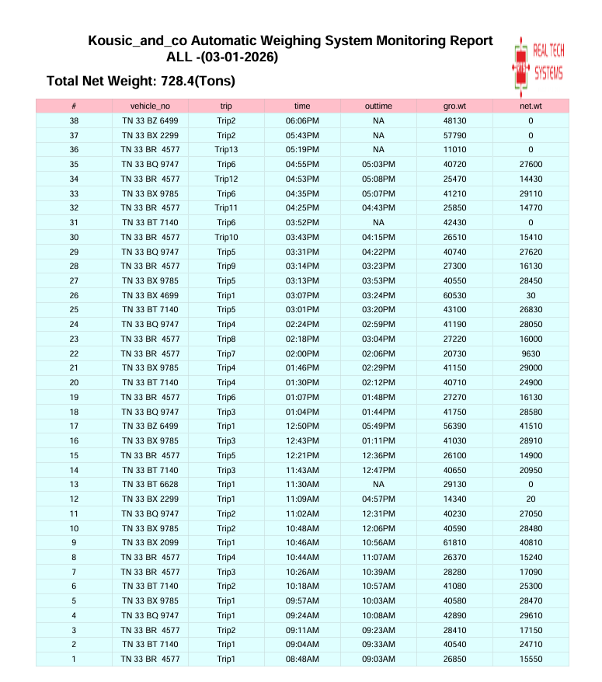

Slide 9
RTS Management Side Requirements
Final Date for Report Update from S/W Team.
Final Date for Mobile Application from S/W Team.
Final Date for Software development from RnD Team.

